Slide 1

28th September 2026
St Clement’s Primary School
DIARY DATES
Deputy Headteacher’s Newsletter
Monday 28th September 2026
1.10.26 - Year 5 Zones of Regulation Worship 2:55pm
2.10.26 - Family Afternoon Tea from 2:15pm
5.10.26 - Harvest Festival with Reverant Dan (parents welcome)
8.10.26 - Year 6 Online Safety Worship 2:55pm
9.10.26 - Coffee Morning with Reverant Dan 8:45am
12th, 13th, 14th - Parent Consultation
15.10.26 - Year 3 Readers Theatre Performance 2:55pm
22.10.26 - Year 4 Readers Theatre Performance 2:55pm
🌟 A Wonderful Start to the Term! 🌟
We have already enjoyed so many wonderful moments this term and are incredibly proud of our children.
A real highlight was our Year 4 residential to Creed Outdoor Learning Centre in Teynham. The children were fantastic, conquering their fears, stepping outside their comfort zones and embracing new challenges. A huge thank you to Miss Fuller and Mrs Turner for accompanying them and making this experience possible – they certainly deserved a well-earned rest afterwards!
We have also been delighted with our class worships. Our focus on Readers Theatre is really paying off, with children becoming increasingly confident when speaking to an audience and projecting their voices clearly.
Last week, we completed our first fire alarm practice of the year. The children were calm and sensible as they left the building and gathered on the all-weather court. Afterwards, we discussed why practising our emergency procedures is so important in helping to keep everyone safe.
It has been a busy and positive start to the term, and we look forward to all the exciting opportunities still to come!

Slide 2

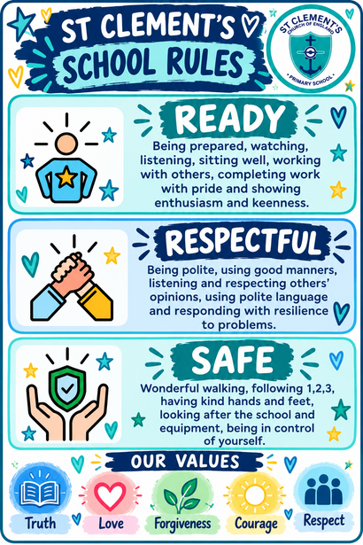
Harvest Festival 🍂
We appreciate that the timing of our Harvest Festival may not be convenient for all of our families. Unfortunately, due to our usual Monday timetable, including sessions with our sports coaches and other class commitments, we are unable to move the service to the end of the school day.
We hope you understand, and if you are able to join us for our Harvest Festival, we would be delighted to welcome you into school to celebrate with us. 💙
💙 Our Values, Rules & Rewards
At St Clement’s, our school values of Truth, Love, Forgiveness, Courage and Respect are at the heart of everything we do. Alongside these, we encourage all of our children to follow our three simple school rules: Ready, Respectful and Safe.
We want every child to make positive choices, show kindness and respect to others, and develop a positive attitude towards their learning. To celebrate this, we use ClassDojo to award points for positive behaviour, effort and attitudes to learning.
As children collect their Dojo points, they can work towards the exciting rewards on our Steps to Success. We love recognising and celebrating the positive choices our children make every day! 🌟

Slide 3
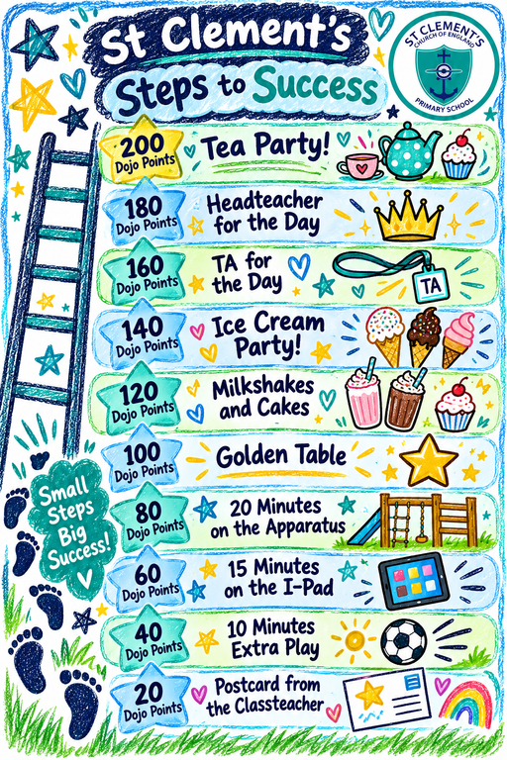




🌟 Celebrating Positive Choices with Dojo Rewards 🌟
At the start of term, we spoke with our children about our Dojo Rewards and listened carefully to their ideas and opinions about the rewards they would most enjoy. Following their feedback, we have now updated our Dojo Rewards, making sure that the children have had a real voice in shaping how we celebrate their achievements.
Throughout each school day, staff praise and award Dojo points to children who are following our behaviour expectations, demonstrating our school values of Truth, Love, Forgiveness, Courage and Respect, and working hard in their learning. Children can then work towards the different rewards on our Steps to Success.
We are really proud of the positive choices our children make each day and love having opportunities to recognise their effort, kindness, behaviour and achievements. Keep collecting those Dojo points! 🌟
Supporting Positive Behaviour at St Clement’s
At St Clement’s, we want every child to feel safe, understood and supported to be successful. Our school rules — Ready, Respectful and Safe — alongside our values of Truth, Love, Forgiveness, Courage and Respect, help children understand the positive choices we expect throughout the school day.
When a child is finding it difficult to make the right choice, staff use our Remind, Remember, Reflect and Restore cards both in the classroom and outside. These provide a clear and consistent approach while giving children opportunities to pause, regulate and make a different choice.
Remind – We calmly remind the child of the behaviour expectation and what they need to do.
Remember – We help the child remember our expectations and encourage them to make a positive choice.
Reflect – If difficulties continue, we give the child time and support to reflect on what has happened and what they could do differently.
Restore – We support the child to have a restorative conversation with an adult, helping them understand what has happened, repair relationships where needed and move forward positively.
An important part of this approach is listening to the child’s voice. We recognise that behaviour is a form of communication and that, at times, a child’s behaviour may be telling us that something is difficult, overwhelming or that they need additional support.
We also recognise that sometimes we may need to adapt the provision around a child to better meet their individual needs. Across the school, we are working hard to identify these needs and put appropriate adaptations and support in place so that children can regulate, engage with their learning and experience success.

Slide 4
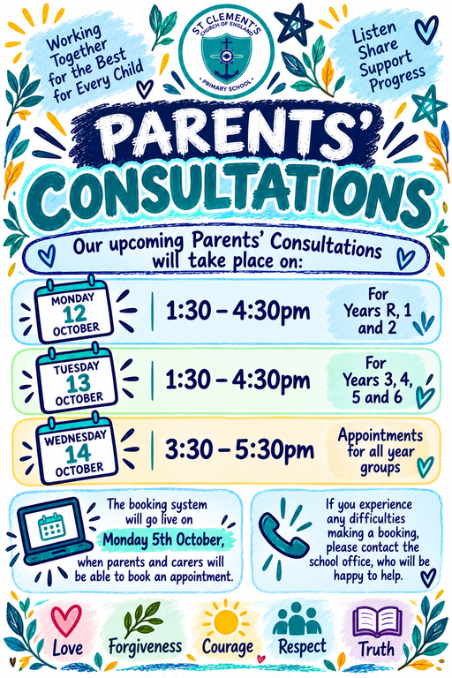


Personalised Plan Meetings
We are currently in the process of organising Personalised Plan meetings for children who are on our SEND register and have a Personalised Plan in place.
These meetings provide an opportunity for your child’s class teacher to share their plan with you, discuss the individual targets they are currently working towards, and talk about the support being provided in school. It is also a valuable opportunity for you to discuss your child’s needs and ask any questions you may have.
We are planning for these meetings to take place during the last week of term and will share further information, including dates and times, in due course. 💙

Slide 5


☕ Coffee, Company & a Little Skipping! 💙
On Friday 9th October, we are delighted to be joined by Reverend Dan, who will be spending some time with us in school for our Coffee Morning from 8:45am–10:00am.
If you fancy a cuppa, some company and a friendly chat, please feel free to pop in and join us – everyone is very welcome! You will also have the opportunity to join some of our children for a fun skipping competition as part of our World Mental Health Day activities.
Skipping is a fantastic way to keep active, have fun and support our mental health and wellbeing – so whether you fancy joining in or would simply enjoy a cuppa and a chat, we would love to see you! ☕💙🌟
💙💙💙

